Slide 1
ECE 3130 – Digital Electronics and Design
Lab 9
State Machines
Fall 2016

Slide 2
What is a State Machine?
A model of a machine that can be in one of several states (e.g. traffic lights)
Different representations:
State diagrams
State tables
State equations

Slide 3
Mealy and Moore State Machines
Mealy machine
Output values are determined by both the current state and the current inputs
Moore machine
Output values are determined solely by the current state

Slide 4
Objectives
Design both Mealy and Moore machines to detect the sequence, 1010, in a bit pattern.
Draw state tables.
Implement the Mealy state machine using D flip-flops with clear pin.

Slide 5
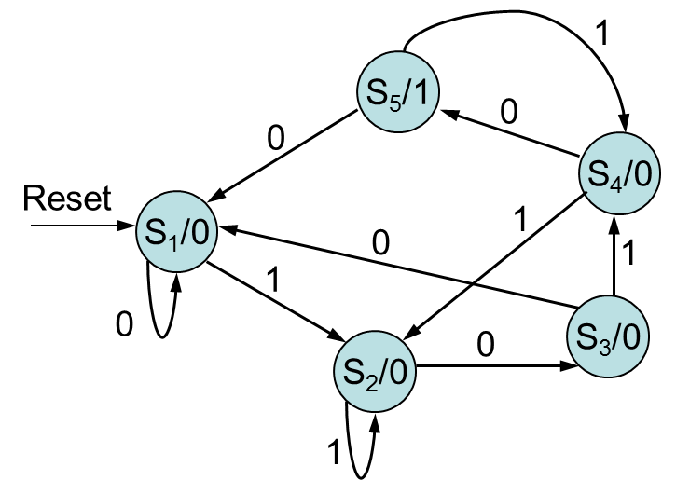
Moore State Machine
Present State | Next State |  | Output
 | Input=0 | Input=1
S₁ (000) | S₁(000) | S₂(001) | 0
S₂ (001) | S₃(010) | S₂(001) | 0
S₃ (010) | S₁(000) | S₄(011) | 0
S₄ (011) | S₃(010) | S₂(001) | 0
S₅ (100) | S₁(000) | S₄(011) | 1
State Diagram
State Table

Slide 6
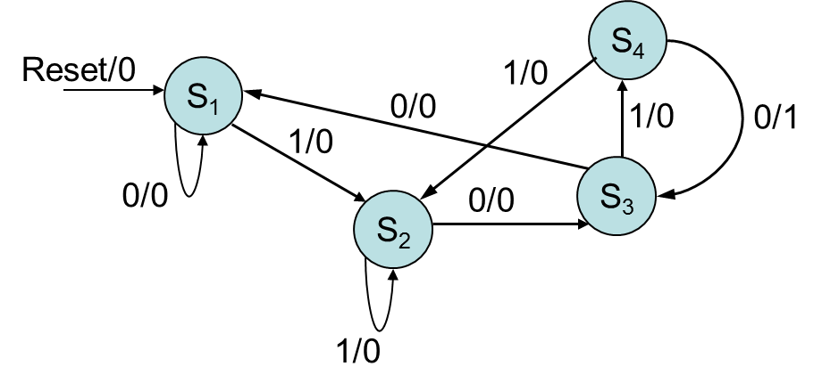
Mealy State Machine
Current State | Next State |  | Output
 | Input=0 | Input=1 | Input=0 | Input=1
S₁ (00) | S₁ (00) | S₂(01) | 0 | 0
S₂ (01) | S₃ (10) | S₂ (01) | 0 | 0
S₃ (10) | S₁ (00) | S₄ (11) | 0 | 0
S₄ (11) | S₃ (10) | S₂ (01) | 1 | 0

Slide 7
Mealy Machine Implementation using DFF
Inputs of combinational circuit |  |  |  |  | Output of combinational circuit
Present state |  | Input | Next state |  | Flip-flop inputs (= Next State) |  | output
A | B | X | A | B | DA | DB | Y
0 | 0 | 0 | 0 | 0 | 0 | 0 | 0
0 | 0 | 1 | 0 | 1 | 0 | 1 | 0
0 | 1 | 0 | 1 | 0 | 1 | 0 | 0
0 | 1 | 1 | 0 | 1 | 0 | 1 | 0
1 | 0 | 0 | 0 | 0 | 0 | 0 | 0
1 | 0 | 1 | 1 | 1 | 1 | 1 | 0
1 | 1 | 0 | 1 | 0 | 1 | 0 | 1
1 | 1 | 1 | 0 | 1 | 0 | 1 | 0

Slide 8
State Equations
DA=A’BX’+ABX’+AB’X
=BX’+AB’X
DB=A’B’X+A’BX+AB’X+ABX
=X
Output=ABX’
All the equations should be simplified via using Karnaugh map.

Slide 9
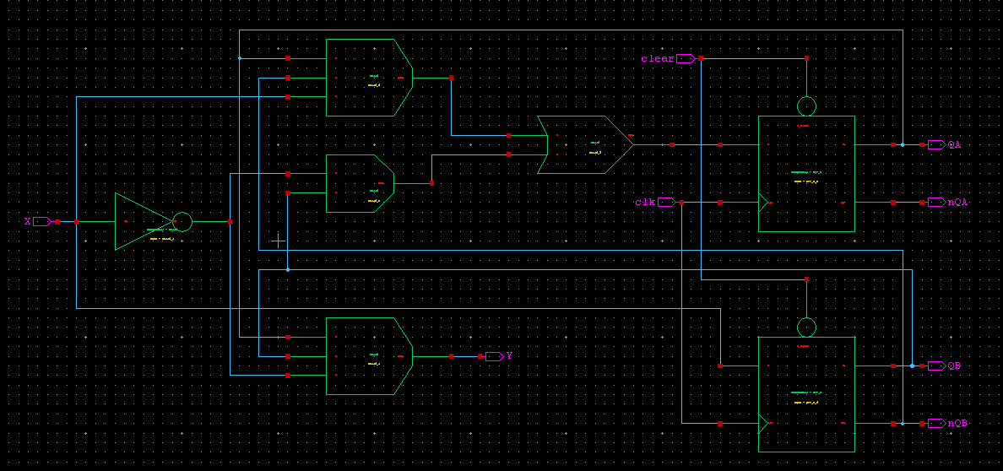
Circuit Implementation

Slide 10

Symbol

Slide 11
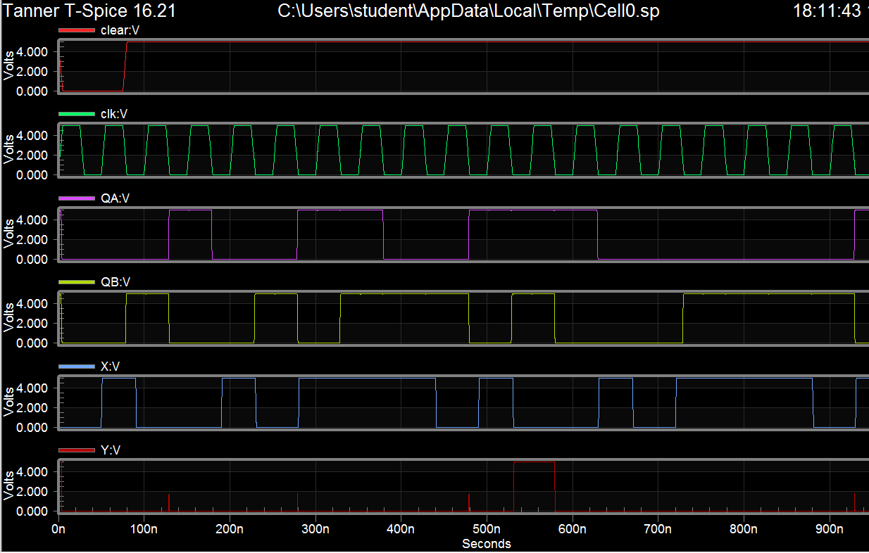
Waveforms

Slide 12
Assignment
Build and test the Mealy State Machine.
Attach all screenshots into one PDF file, including schematic, symbol, test circuit schematic, waveforms.

